Slide 1
Pray to God for protection against corona virus
Pray for those with special needs in their lives, those who are sick, need deliverance
Let’s pray for unity in the world
Let’s pray for the holy spirit to fill us
People from China can’t go back home cause of the coronavirus but we still pray for them and Whyalla and the whole Earth. -
Lord I pray against the Corona Virus. It is causing so much hysteria and concern. I know that you are in charge of all things, so I know that you can wipe out this virus, and you will in your own time. Be with us all and keep us safe in your hands and comfort those who have already lost loved ones and heal those who have contracted it. I ask in your mighty name and thank you for all you do and give us.

Slide 2
Health and Healing. Peace-Calmness
People being less selfish, when doing their shopping so others can survive as well. Let not your hearts be troubled for where I am, you are also.
Prayer for children to grow in their for Christ and a desire to follow Him.
Strengthened marriages and relationships
Health
I am the same yesterday, today and forever
“Your Rock
Your Peace”
Notes:
Heart Asterix

Slide 3
Praying for more knowledge, wisdom and God’s protection to everyone. Amen.
Joshua 1:9
Do not be afraid or discouraged for the Lord your god is with you where ever you go.
Lord, may we recognise you in this time of pandemic, as economies, nations, continents, families and individuals are brought to their knees-symbolically and figuratively
That people will turn back to God and trust in Him
That people will question the way the world is going, the consequences and the hurt this causes.

Slide 4
Why are you looking for the living among the dead?
Though I walk through the valley of the shadow of death I will fear no evil for you are with me. Your rod and staff they comfort me.
There will be wars and rumour of wars – I am with you.
From the rising of the sun to the going down of the same, Yahweh is to be praised.
John 10:10 The thief’s purpose is to steal and kill and destroy. My purpose is to give them a rich and satisfying life. (In the light of coronavirus)

Slide 5
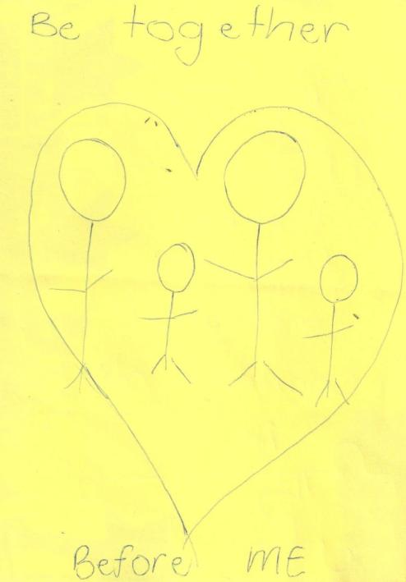
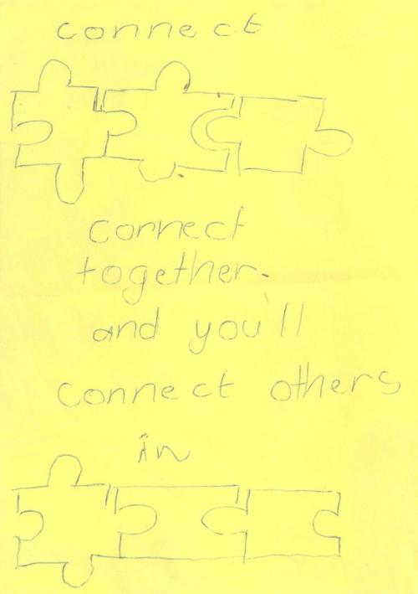

Slide 6
To pray to God that this pandemic would soon end. To pray for calmness in facing the pandemic. To pray for my family’s health, including the world.
God our father, please protect our hearts so much to fear to over think. Help us to look to you. Keep our eyes fixed on you. Keep our mouths shut for the drama- but help us to speak life, speak peace and understanding.

Slide 7
John 3:16
For God so loved the world that he gave his one and only Son, that whoever believes in him shall not perish but have eternal life.
1 Peter 5:7
Cast all your anxiety on him because he cares for you.
Pray the verses you know over Whyalla.

Slide 8
I pray for your spirit to anoint us.
Luke 4:18
“The Spirit of the Lord is on me, because he has anointed me to proclaim good news to the poor. He has sent me to proclaim freedom for the prisoners and recovery of sight for the blind, to set the oppressed free”

Slide 9
Matthew 18:20
For where two or three gather in my name, there am I with them.
Praise God that your word says clearly that you are with us in our church and in Whyalla.
Greater is He that is in me then he that is in thes world.
Increase my faith Lord Jesus.
God you are in control.

Slide 10
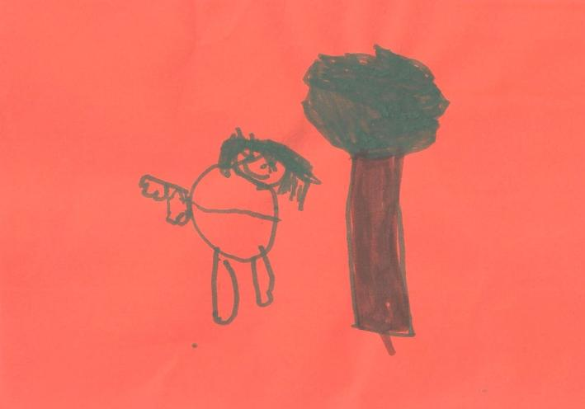
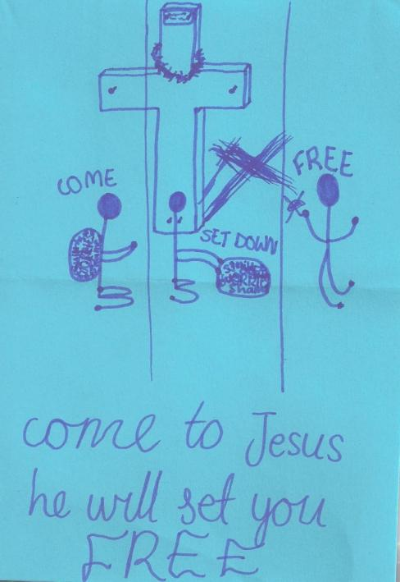
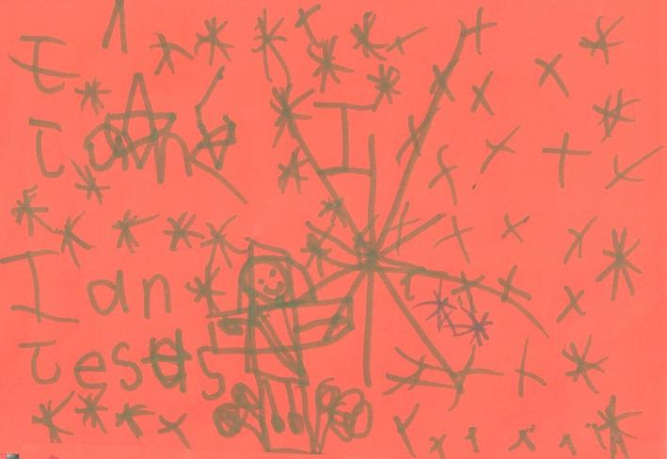

Slide 11
How can I love others in these uncertain times?
Help me to be strong for my friends and family?
Fear not for I am with you said the Lord.
Jesus all for Jesus.
Psalm 46:10 Cease striving and know that I am God.
Do not be shaken by the things that shake this world. For you are receiving a kingdom that cannot be shaken. Trust in me and do not be afraid. For what can people do to you? Would you risk eternity for others our of fear for yourself?

Slide 12
If they cannot see me in you, individually and corporately how will they see me at all. I have given you a spirit of light and power, not a spirit of camouflage!
Corona virus – vaccine. Our emergency services and medical staff, teachers, the elderly, sick and fragile. Politicians and leaders. Your church, schools, entertainment industry, service industry – shop assistants, tellers (finance), Dom Care.
Patience, peace and joy. Love and compassion, mercy.

Slide 13
I pray for people who don’t have a loving family.
When you know someone loves you, you feel good.
Let all you do be done in love.
Revelation 3:20
Here I am! I stand at the door and knock. If anyone hears my voice and opens the door, I will come in and eat with that person, and they with me.

Slide 14
2 Timothy 4:7
I have fought the good fight, I have finished the race, I have kept the faith.
That people will turn back to God and trust in Him.
That people will question that way the world is going, the consequences and the hurt this causes.
Illness – health
Sadness – joy
Tears – smiles
Disappointment – thankfulness
God can turn negatives around

Slide 15
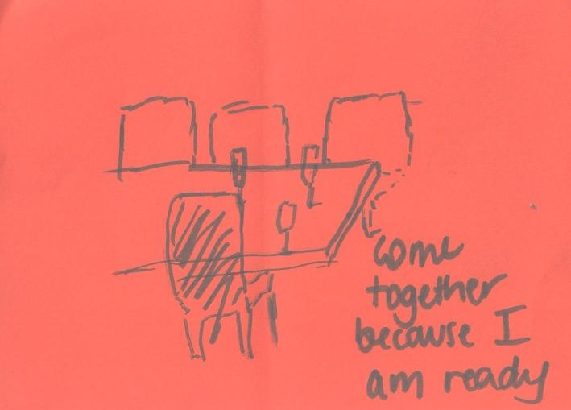
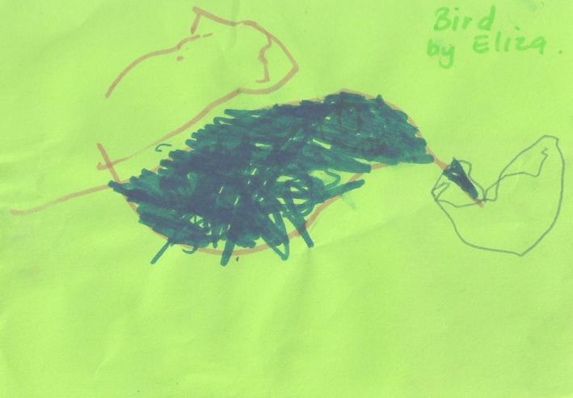
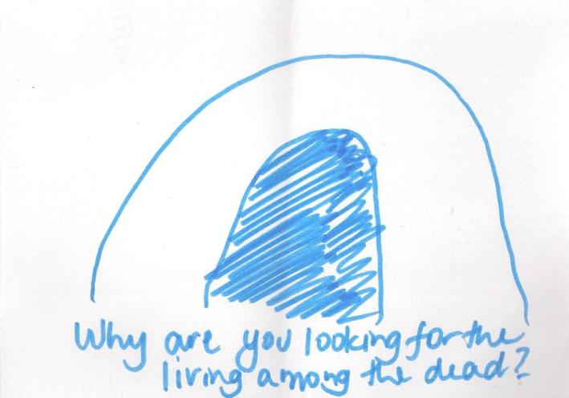
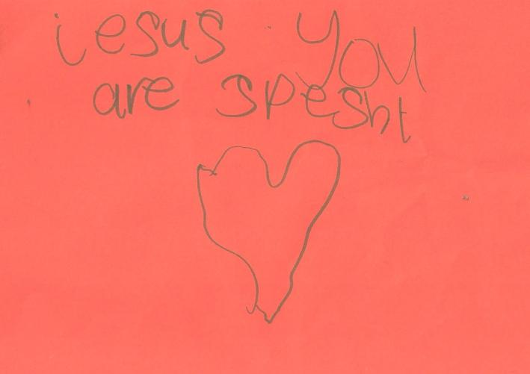

Slide 16
Getting everyone together to help people in the community that are unable to get help for themselves or who just want helping or wanting someone to be there to listen and offer advice if they need it.
Lay aside every weight and the sin that so easily ensnares us and let us run!!
What is weighing you down? Lay it aside. Take time to live in the moment and see what God is doing or trying to teach you. Don’t look back or forward – regretting or planning.

Slide 17
Father God, in our times of happiness and sadness You are always there in our lives forever faithful. I pray for my family, friends and relatives in whatever circumstances we are in it would be an opportunity to share support, encouragement and love for each other. I continuously pray to put in my life the full armour of God and through Your Holy Spirit we rest in Eternal life in Jesus mighty name, to God be the glory! Hallelujah, Amen.

Slide 18
Matthew 25:37-40
“Then the righteous will answer him, ‘Lord, when did we see you hungry and feed you, or thirsty and give you something to drink? When did we see you a stranger and invite you in, or needing clothes and clothe you? When did we see you sick or in prison and go to visit you?’
“The King will reply, ‘Truly I tell you, whatever you did for one of the least of these brothers and sisters of mine, you did for me.’

Slide 19
Those people who have been embittered by the breakdown of a family relationship and find it difficult to forgive and trust again. Let them be able to put behind the bitterness, to forgive and to find peace and joy in life again.

Slide 20
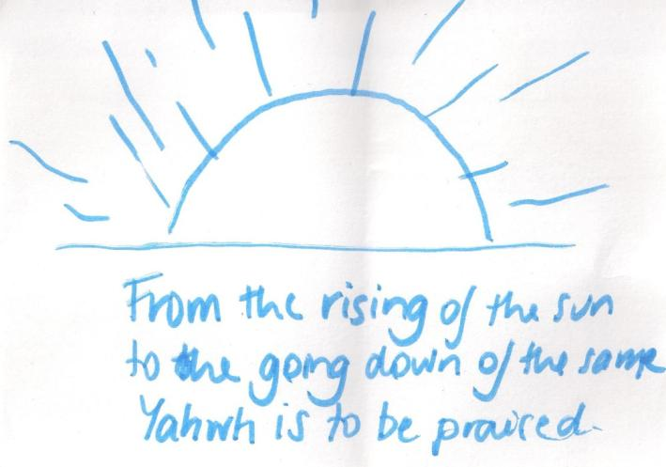
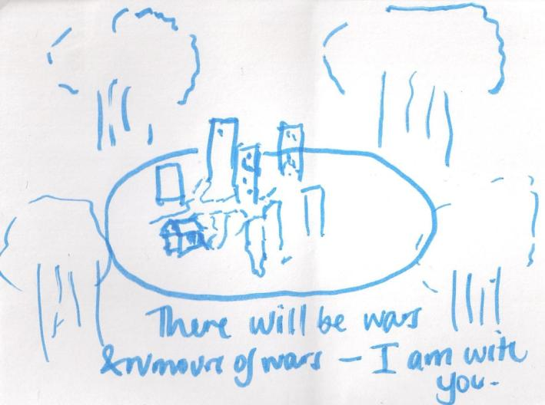
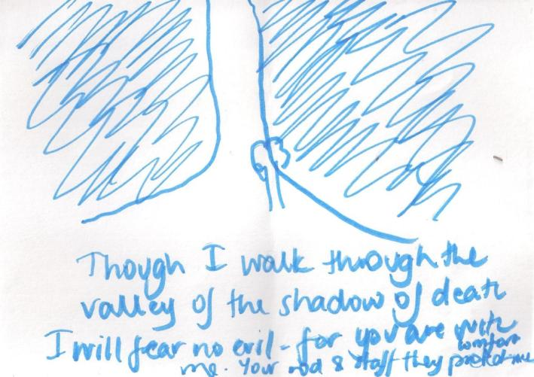

Slide 21
